Slide 1


Café Great Transactions Case Study

Slide 2
Data Description:
The data set provided is of a Café Chain for one of its restaurants. Objective is to do a thorough analysis of the data and come up with the following analysis.
The owner of the restaurant wants us to use this data to come up with a set of recommendations that can help his Café Chain increase his revenues. He has not been able to launch a loyalty program and is unable to provide us with a data set that has customer level information. But, he is able to provide us with a data set for POS (point of sale data) for one of his chains.

Slide 3
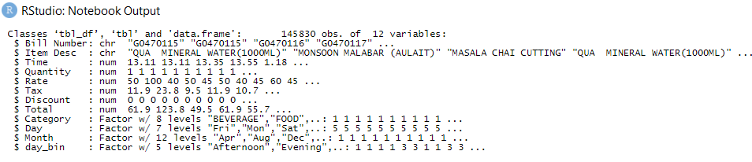
Data Preparation:
The data set consists of 145830 observation and 12 variable and no missing values.
New variables such as Day( day of the week), Month(month of the transaction) and day_bin( time of the day, 4.00am to 12.00pm as morning, 12.01pm to 16.00pm as afternoon, 16.01pm to 19.00pm as evening, 19.01pm to 23.59pm as night and 00.00am to 3.59am as late night/early morning).

Slide 4
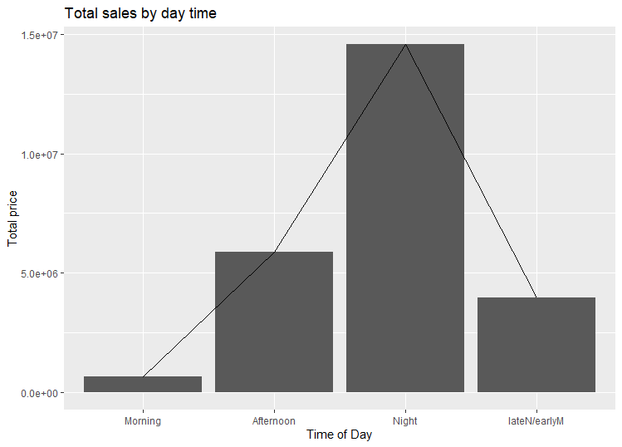
Exploratory Data Analysis
At first, have gone ahead and analysed the sales
pattern across different time of day.
Night seems to be the peek time for sales.
The patterns looks like a normal distribution,
Sales gradually rises and falls towards late night or
early hours of morning.

Slide 5
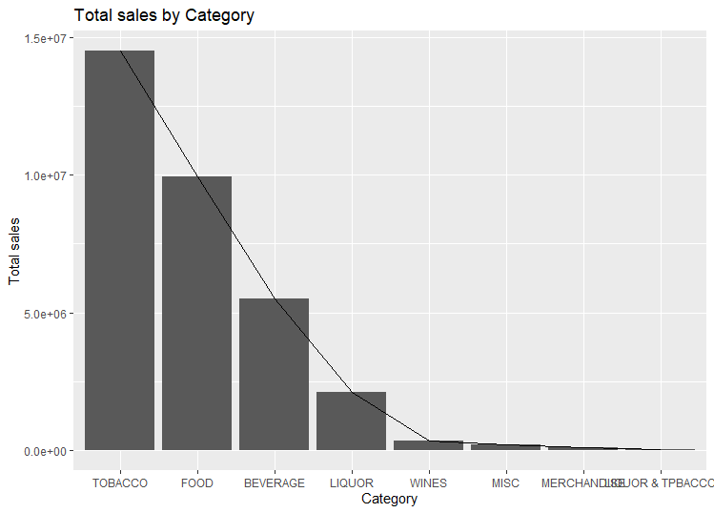
Analysing the total sales across category, shows that Tobacco, Food and Beverages are the top 3 selling category.
Most frequently ordered items in the top 3 categories are Nirvana Hookah Single, Great Lakes Shake and Cappuccino respectively.

Slide 6
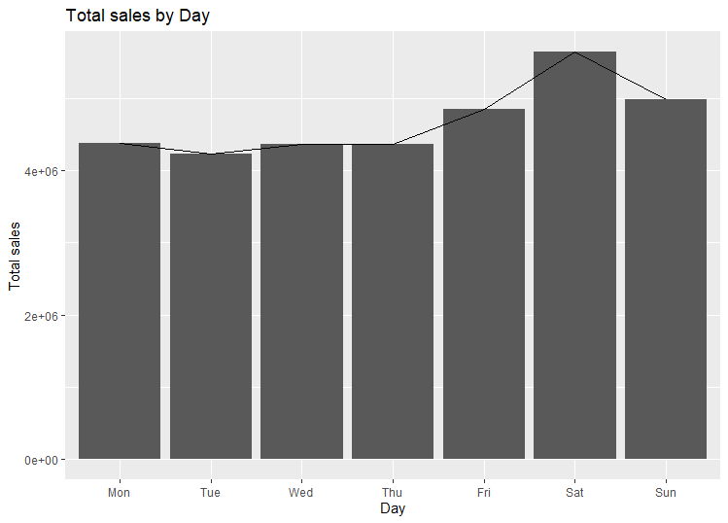
Analysing the total sales across days of the week, shows weekends to have the highest sales.

Slide 7
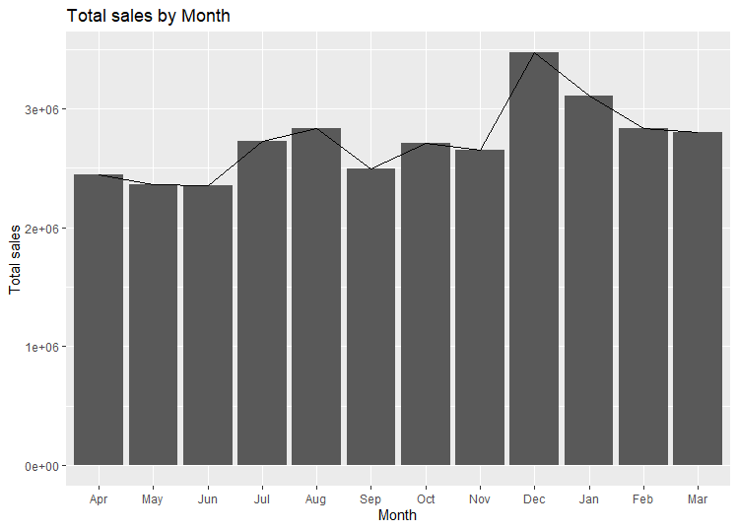
Analysing the total sales across Months, shows sales rises up during July and August then again towards the end of the years in December and then gradually falls towards the beginning of the year during January, February and March.

Slide 8
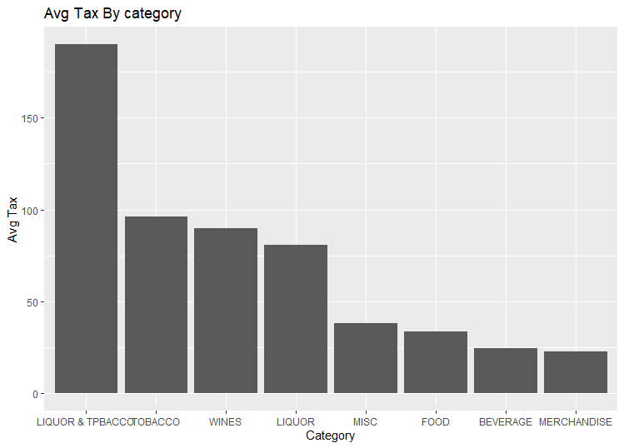
Analysing average tax across categories, shows Liquor and Tpbacco incur the highest tax and are least items frequently ordered item across categories.

Slide 9
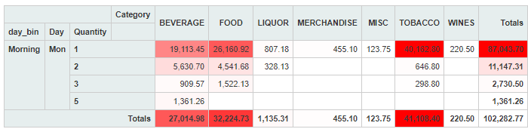
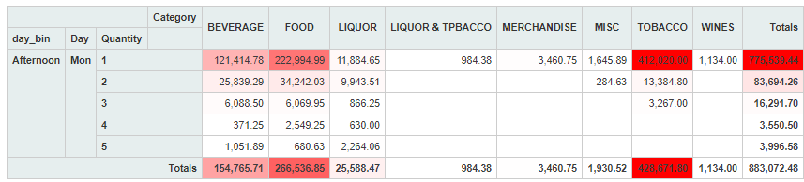
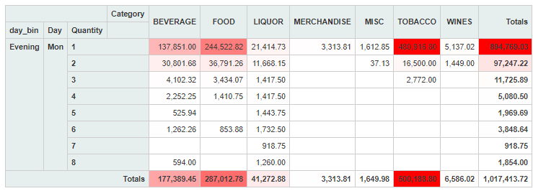
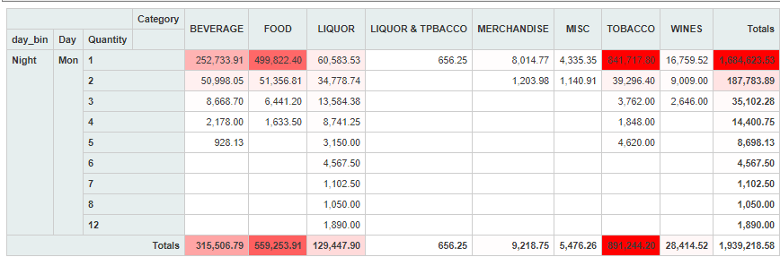
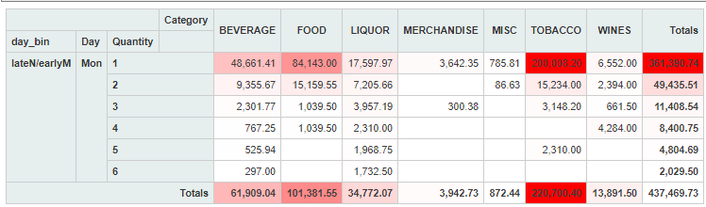
Analysing the sales across category by days and time of the day, shows the following.
Analysis of Monday:

Slide 10
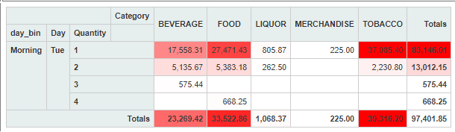
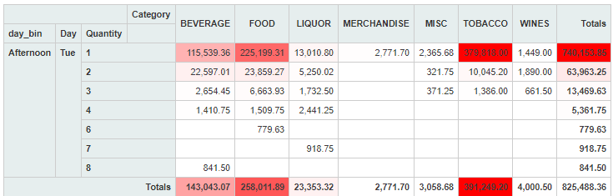
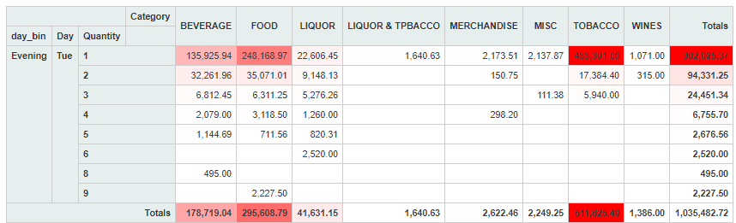
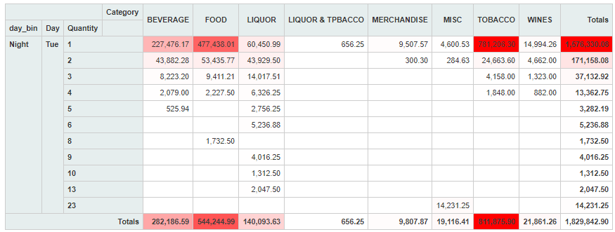
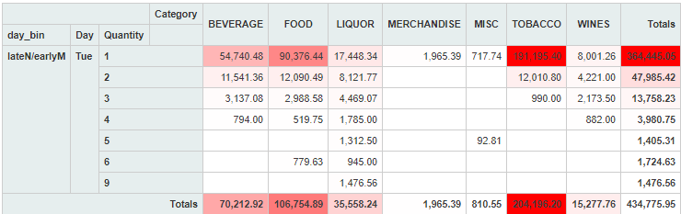
Analysis of Tuesday:

Slide 11
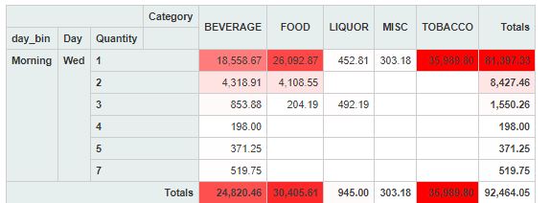
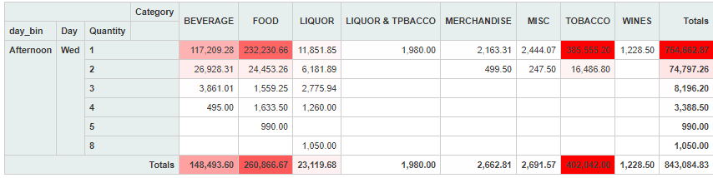
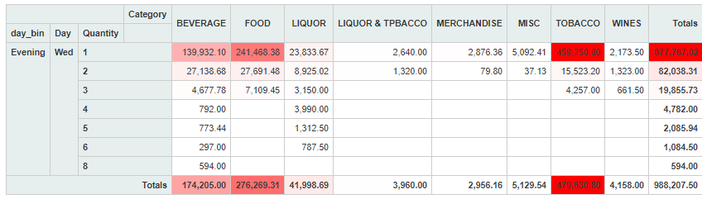
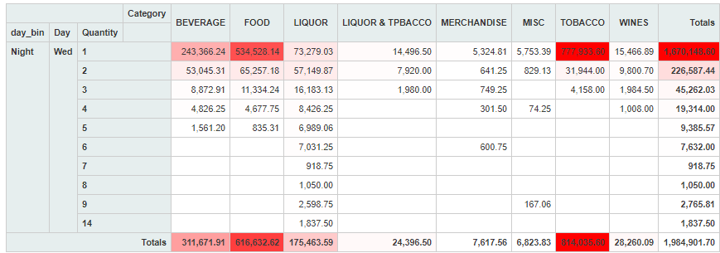
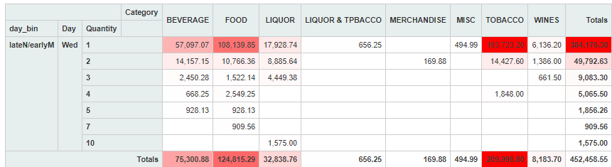
Analysis of Wednesday:

Slide 12
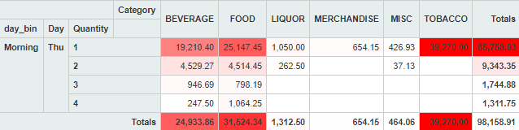
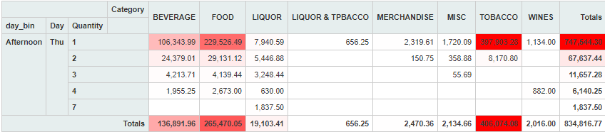
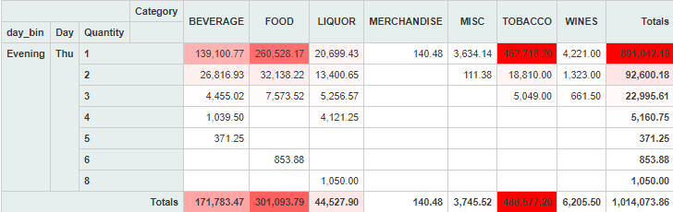
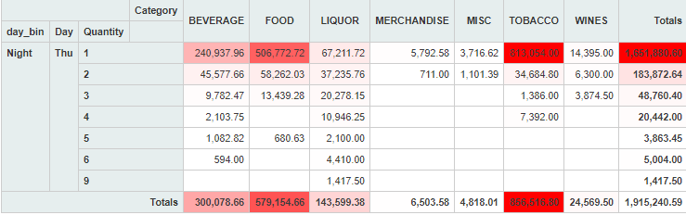
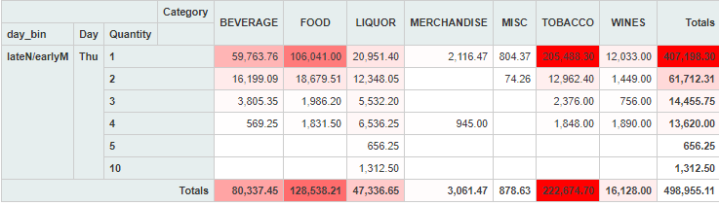
Analysis of Thursday:

Slide 13
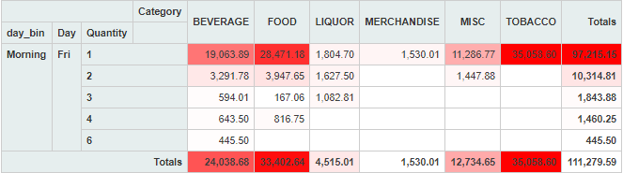
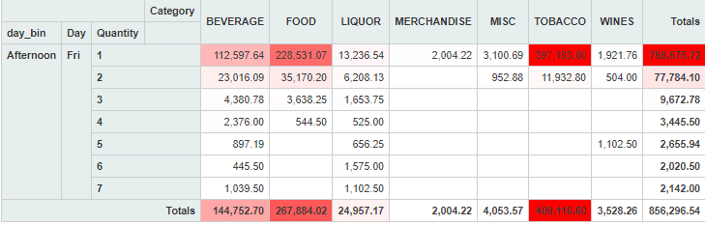
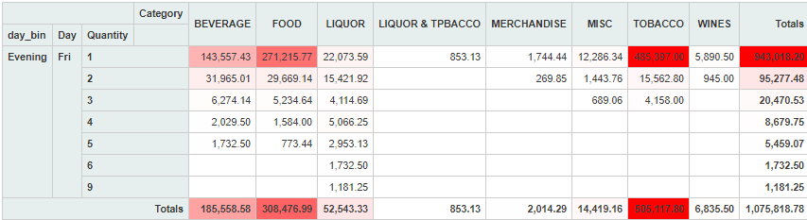
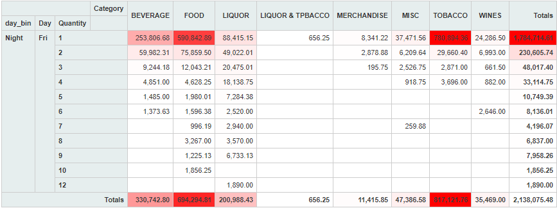
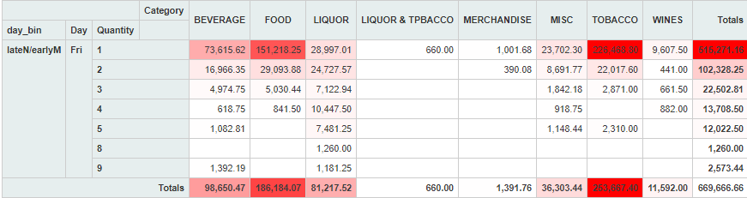
Analysis of Friday:

Slide 14
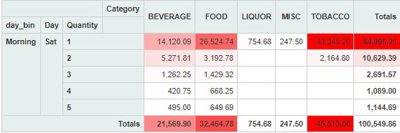
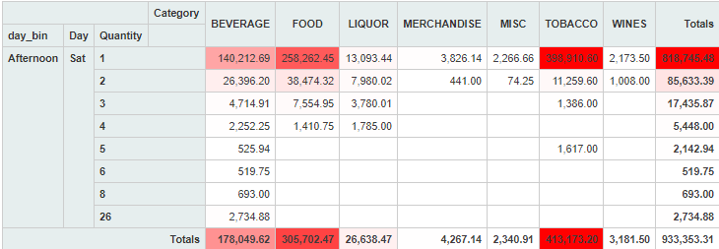
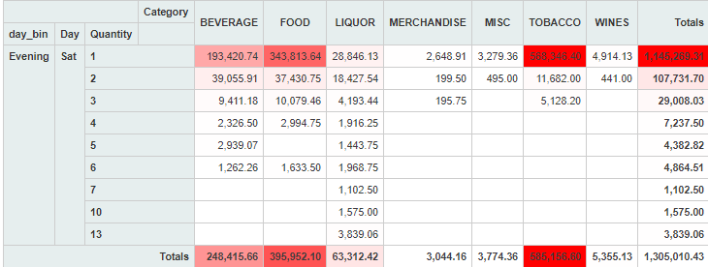
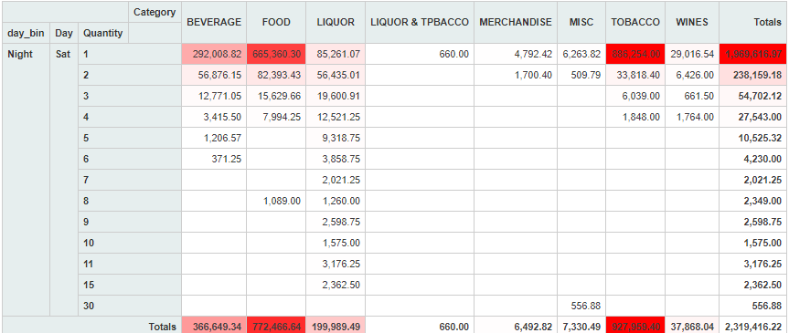
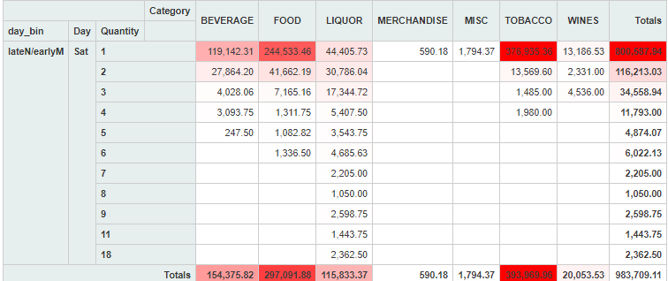
Analysis of Saturday:

Slide 15
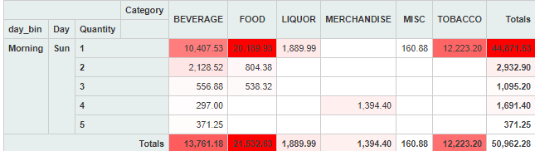
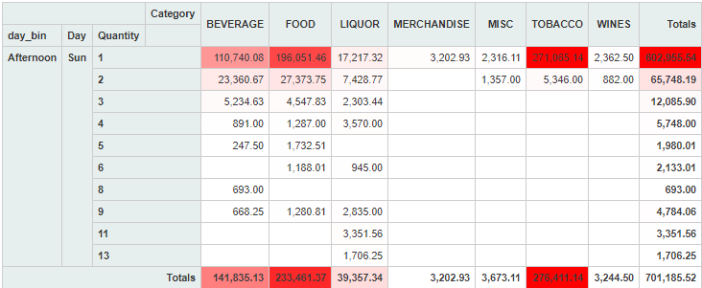
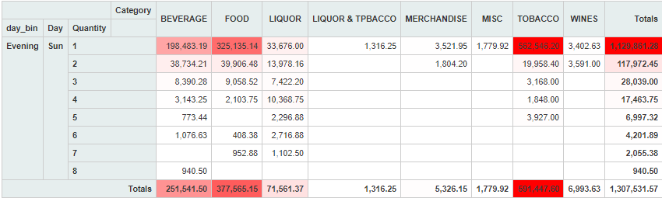

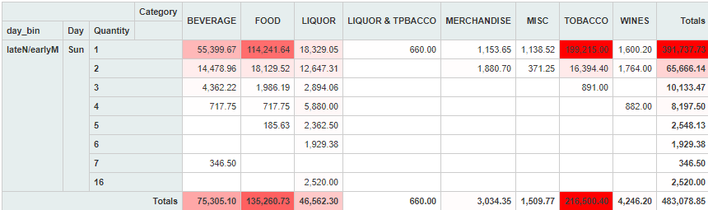
Analysis of Sunday:

Slide 16
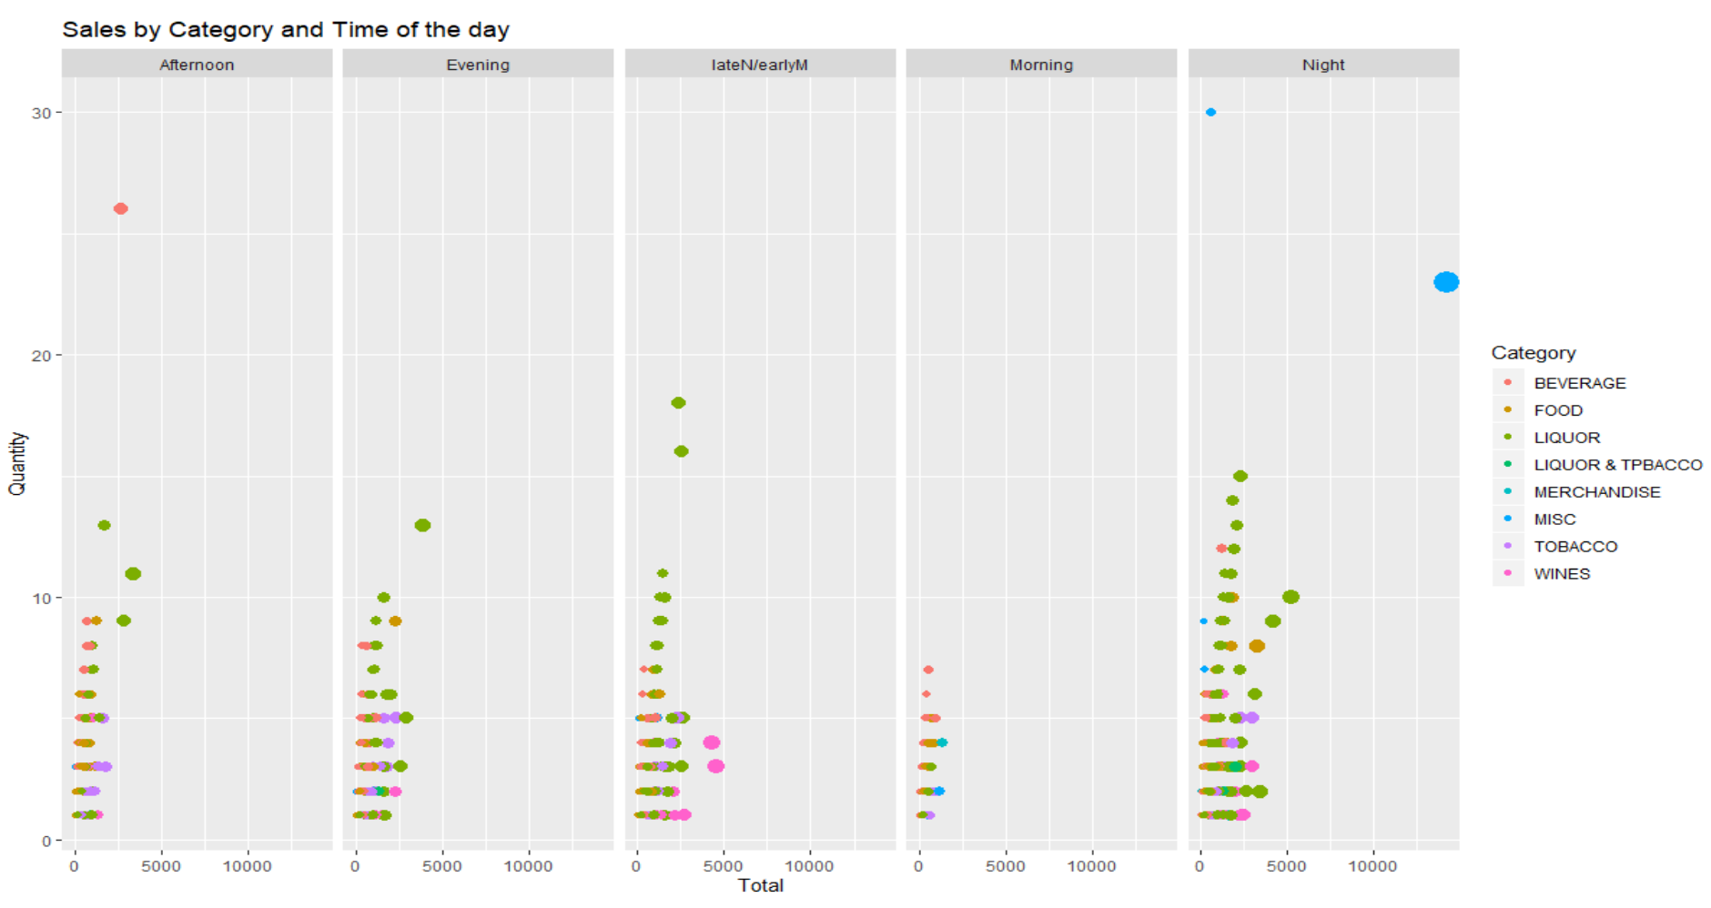
Analysis of Consumer behaviour/sales by time
In terms of Quantity and Sales, Misc.(only at nights), Beverages (in the afternoons) and Liquor(Through out the day) seem to dominate
Wines generates good amount of sales at less quantity post midnight.
Tobacco generates the highest revenue regardless of quantity day or time etc.,

Slide 17
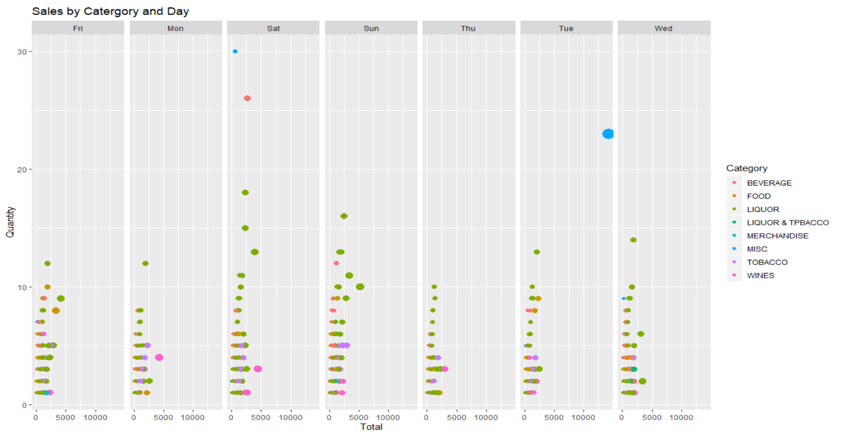
Analysis of Consumer behaviour/sales by Day
In terms of Quantity and Sales, Misc.(only on Tuesdays) seems to dominate.
In terms if quantity Beverages dominate on Saturdays.
Liquor in terms of quantity and sales seems to be consistent through out the week except on weekends.

Slide 18
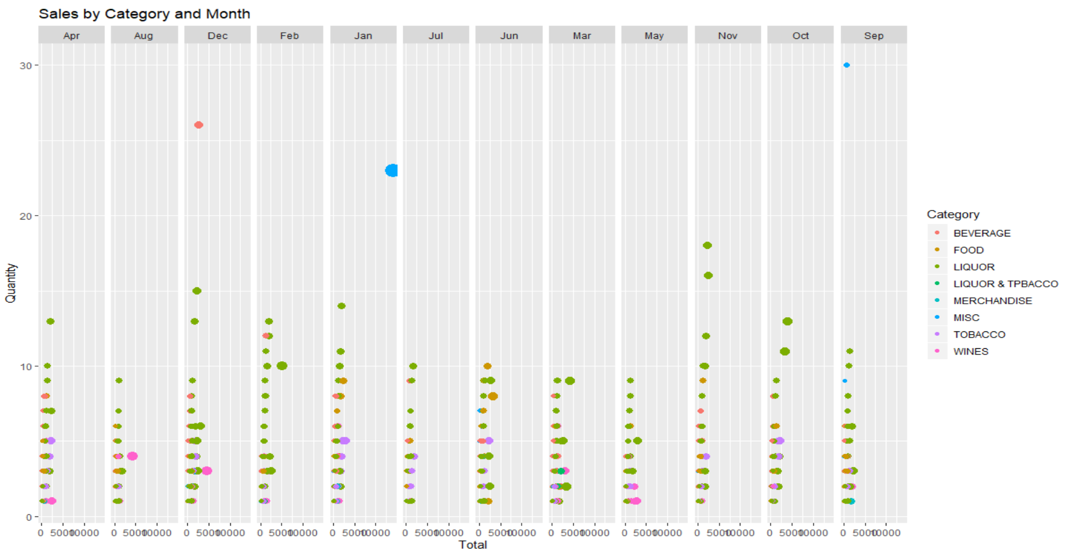
Analysis of Consumer behaviour/sales by Months
In terms of Quantity and Sales, Misc.(only in January) seems to dominate.
Misc. and Beverages in September and December seem to dominate only in terms of quantity.
Liquor seems to dominate in terms of quantity across all months except June, September and December.

Slide 19
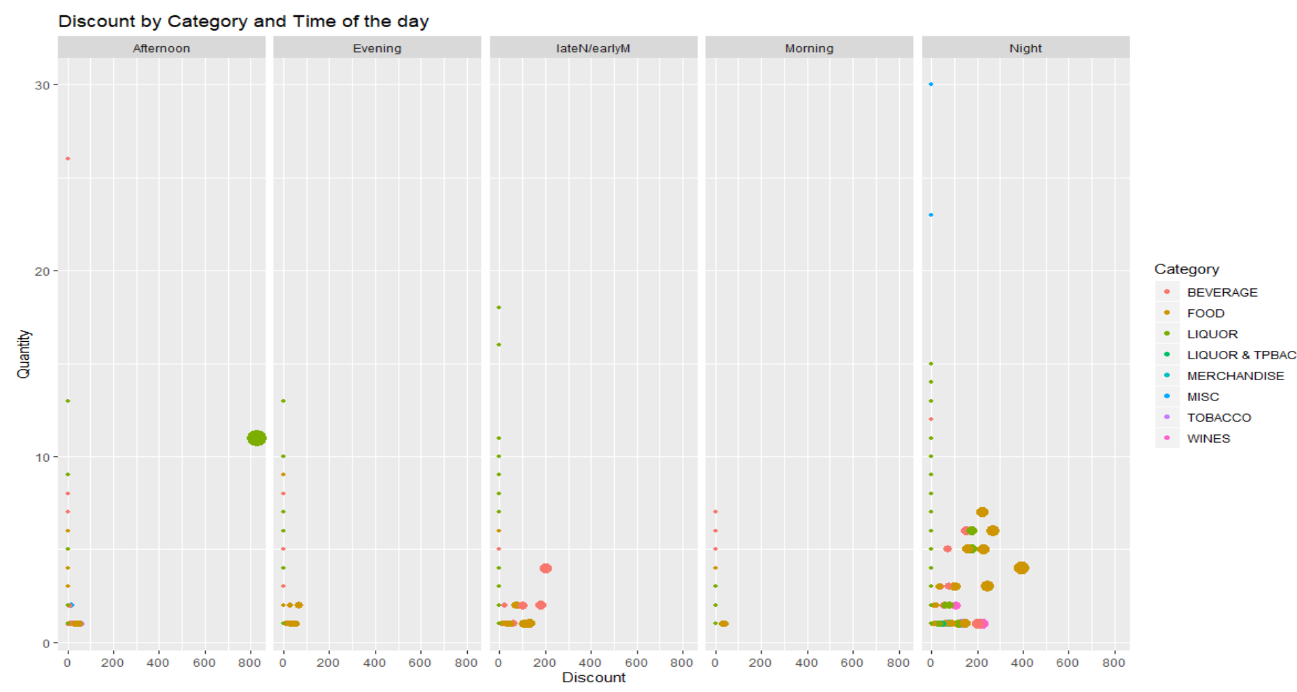
Analysis of Discount based on time.
In terms of Quantity and Discount Liquor in the afternoons seems to be high.
Food has high Discounts during Nights
Beverages has high discounts during late nights or early mornings.

Slide 20
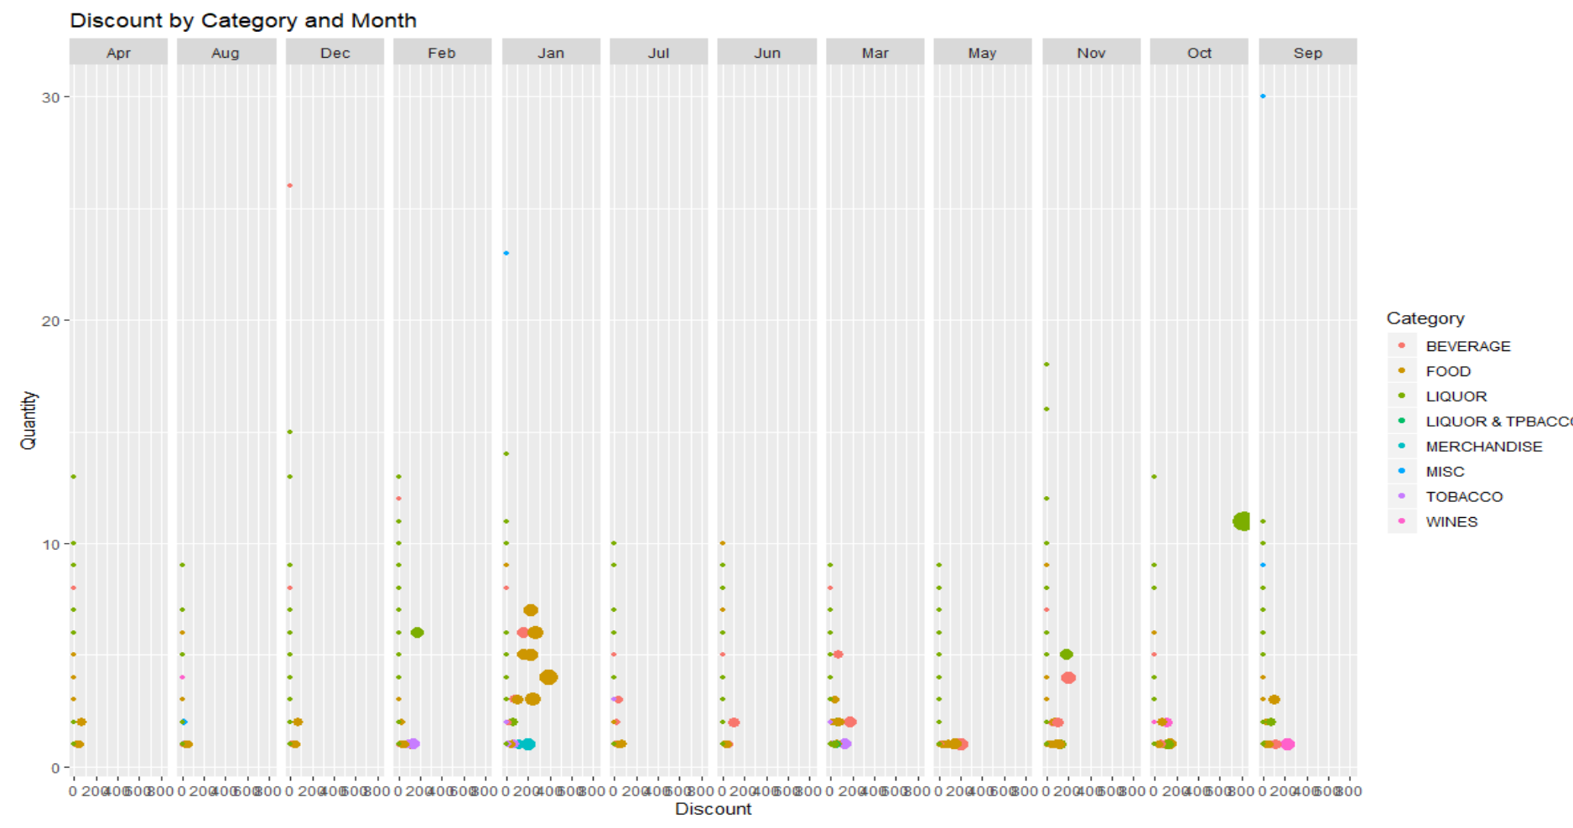
Analysis of Discount based on Months.
In terms of Quantity and Discount Liquor in the Month of October seems to be high.
Food has high Discounts in the month of January along with Beverages and Merchandise.
Wines have discounts in the month of September.

Slide 21
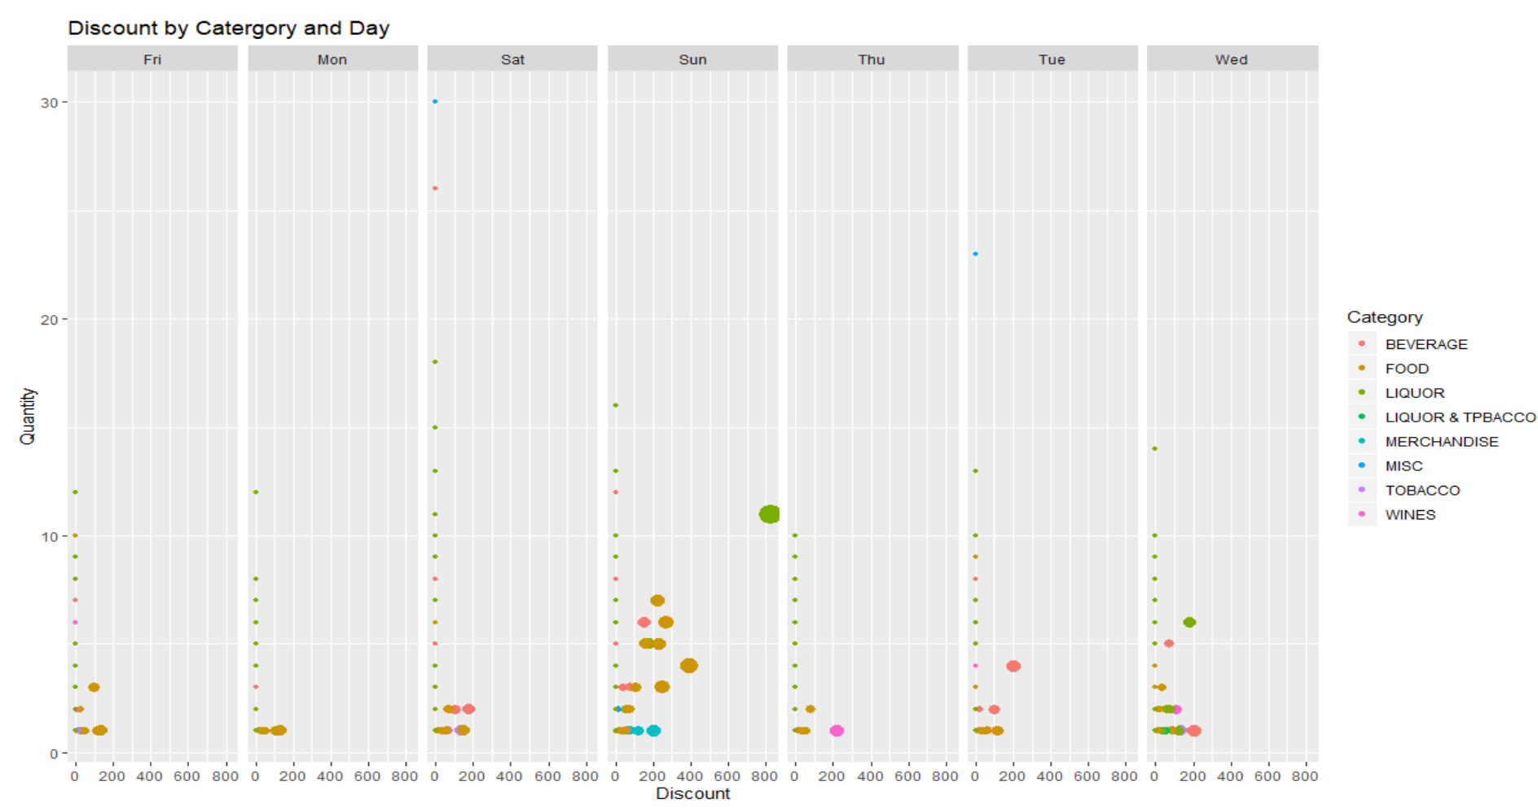
Analysis of Discount based on Days
In terms of Quantity and Discount Liquor seems to dominate on Sundays along with Food and Merchandise.
Beverages on Tuesdays and Wednesdays and Saturdays have discounts.
Wine seems to high discount only on Thursdays.

Slide 22
Recommendations:
Items under the category Liquor and Tpbacco named, “Beer Hookah”, “2 & 4 Dom Beer+1 Spl Sheesha”, can be taken of the menu as these items generate the lowest revenue when compared with other items and these items have higher tax as well.
Discounts on Liquor can be extended up until 19.00pm to gain more customer, This may be applicable on Saturday as well as most of the discounts on Liquor happens mostly on Sundays and in the month of May and June discounts can be extended to weekdays as well, as sales of Liquor in these months is less compared to the other months.
Discounts on Beverages, Food in the month of May and June to increase sales.
Discount on Wines in the month of July to raise sales of wines.

Slide 23
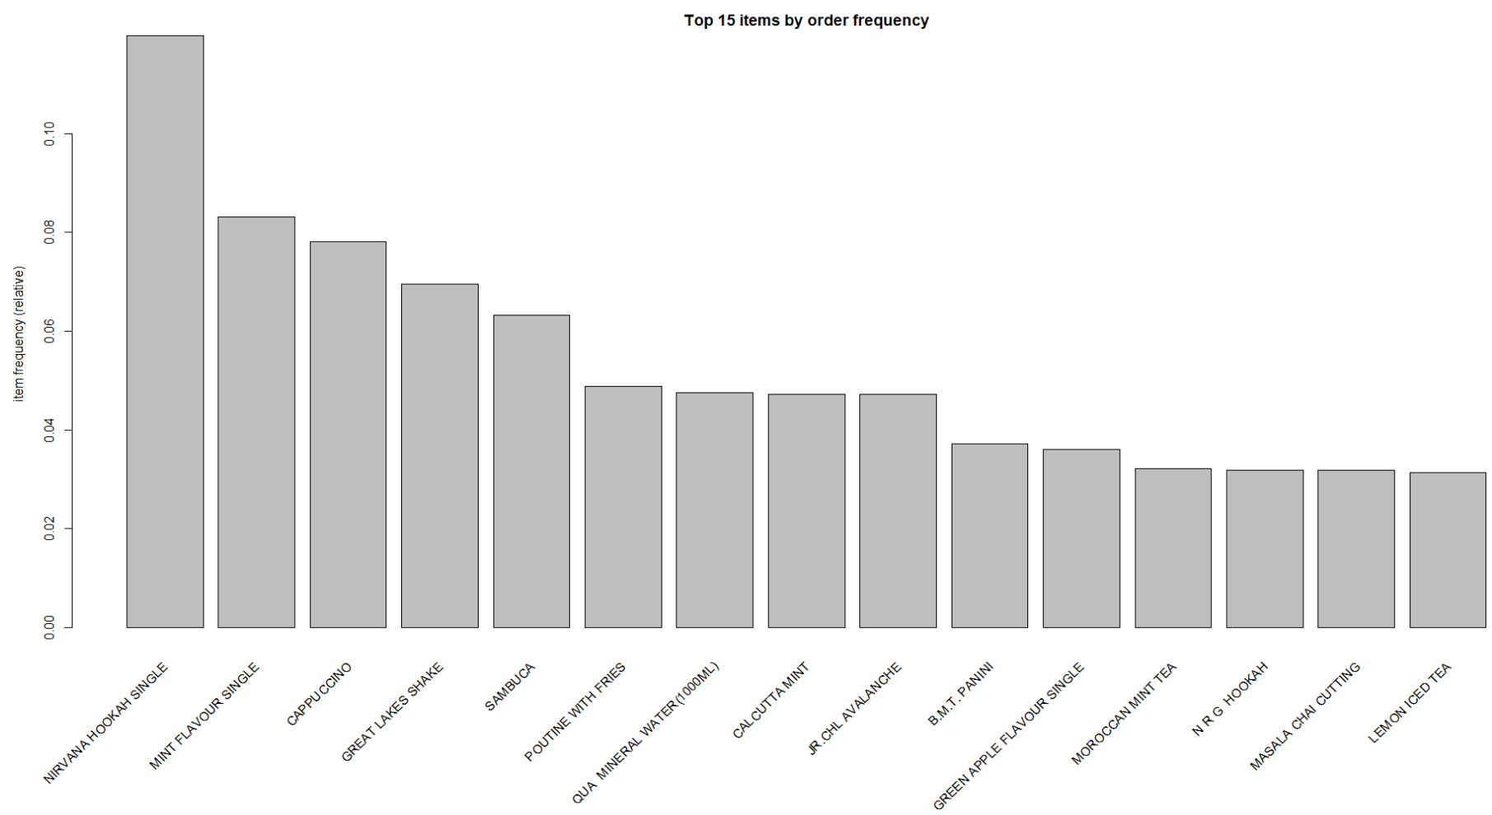
Menu Analysis:
Top 15 Items Description by order frequency.

Slide 24
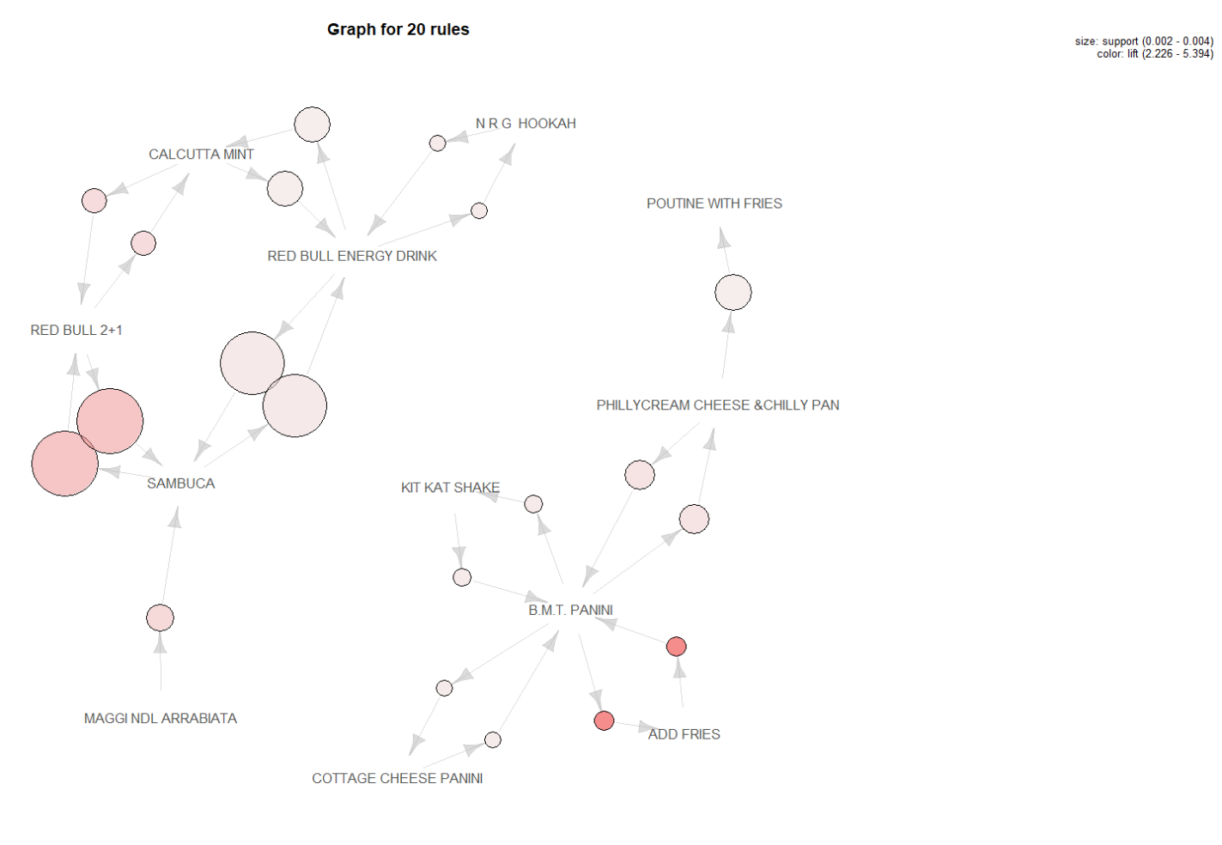
Recommendation 1 for combo meals:
BMT Panini and Kit Kat Shake
BMT Panni and Cottage Cheese Panini
BMT Panini and Add Fries
BMT Panini and Philly Cream & Chilly Pan
Philly Cream & Chilly Pan and Poutine with Fries.

Slide 25
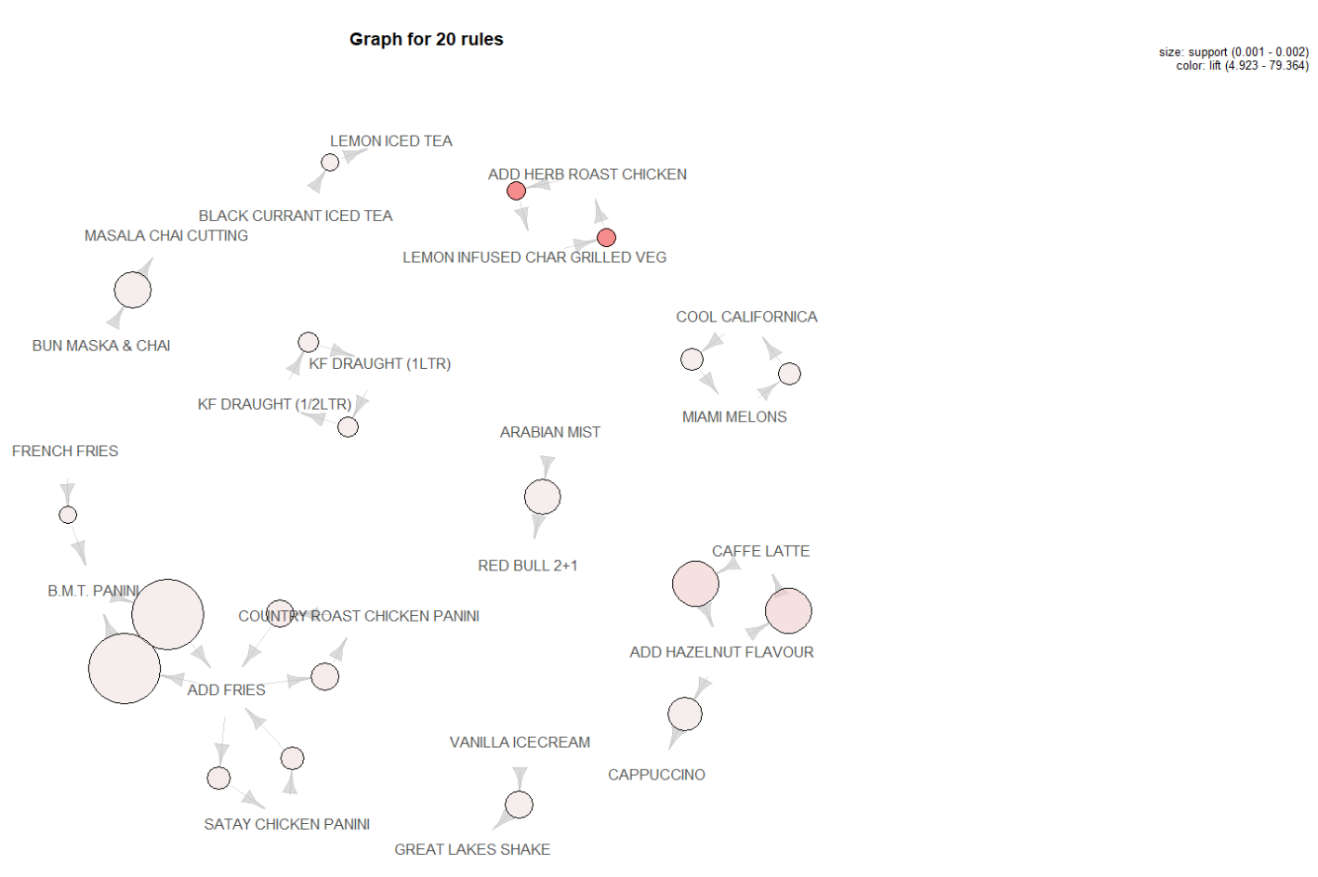
Recommendation 2 for combo meals:
Country Roast Chicken Panini and Add Fries
Satay Chicken and Add Fries
BMT Panini and Add Fries
Great lakes shake and vanilla ice cream

